Slide 1
ENGLISH VOCABULARY & PRONUNCIATION LEARNING APPLICATION
BCXIIIE Senior Project
Author: Diep (Rocky) X.MAI

Slide 2

OVERVIEW
What is this project about?
This project builds An “English Vocabulary & Pronunciation Learning System”
The system can help people learn vocabularies with topics, take a lot of tests, and play games.
The system allow people to check their pronunciation as well.

Slide 3
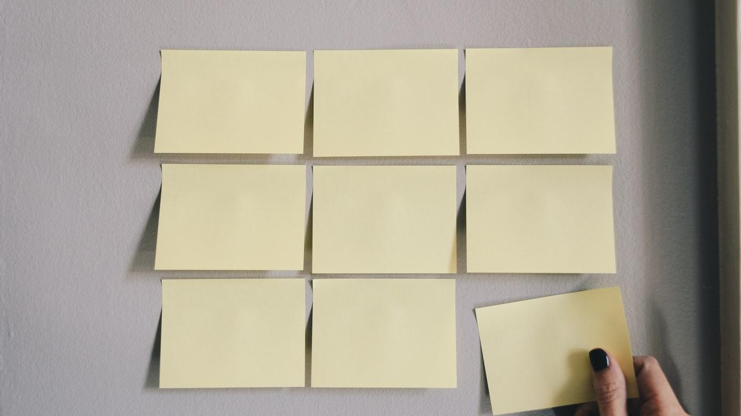
TARGET USER
Vietnamese.
Children.
The people who want to improve English vocabulary and pronunciation.

Slide 4
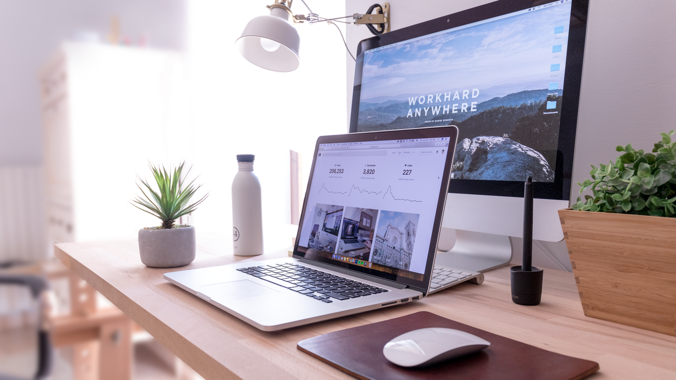
ACTORS
Admin of System
User
Create and update Data
Get Data

Slide 5
CRUD Flashcard
Login
Business Process
Admin
Authentication & Authorization
WEB
API
Provide data of Flashcards
Check pronunciation of user
Login
Learn Vocabularies
Take tests
WEB
API
Download/Update Flashcards
Check pronunciation
Play games

Slide 6
SYSTEM ARCHITECT
Query data
WEB API
DATABASE
Request data service,
account service
CRUD Flashcard
Provide services
ADMIN
USER

Slide 7

SOFTWARE DEVELOPMENT PROCESS
1
Design Database
1
Develop iOS Application
2
Test manual

Slide 8

1.
TRANSITION HEADLINE
Let’s start with the first set of slides

Slide 9

HELLO!
I am Jayden Smith
I am here because I love to give presentations.
You can find me at @username

Slide 10

“Quotations are commonly printed as a means of inspiration and to invoke philosophical thoughts from the reader”

Slide 11

BIG CONCEPT
Bring the attention of your audience over a key concept using icons or illustrations

Slide 12
YOU CAN ALSO SPLIT YOUR CONTENT
White
Is the color of milk and fresh snow, the color produced by the combination of all the colors of the visible spectrum.
Black
Is the color of ebony and of outer space. It has been the symbolic color of elegance, solemnity and authority.

Slide 13

IN TWO OR THREE COLUMNS
Yellow
Is the color of gold, butter and ripe lemons. In the spectrum of visible light, yellow is found between green and orange.
Blue
Is the colour of the clear sky and the deep sea. It is located between violet and green on the optical spectrum.
Red
Is the color of blood, and because of this it has historically been associated with sacrifice, danger and courage.

Slide 14
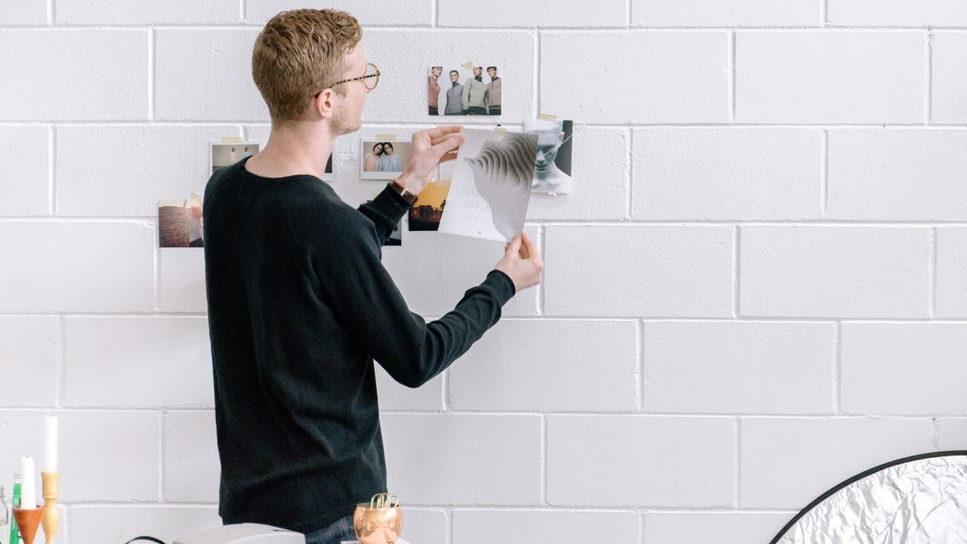
A PICTURE IS WORTH A THOUSAND WORDS
A complex idea can be conveyed with just a single still image, namely making it possible to absorb large amounts of data quickly.

Slide 15

Want big impact?
USE BIG IMAGE.

Slide 16
AND TABLES TO COMPARE DATA
Develop Account Feature - iOS
Develop Download, Update Data Feature - iOS
Develop Learn Vocablary Feature - iOS
Develop take tests, play games Feature -iOS
Test iOS App | 24
Design Database
Develop CRUD Account, Flashcard API
Build Speech To Text Model
Test Web API
Develop Admin Website | 24

Slide 17
SYSTEM ARCHITECT
01
Vestibulum nec congue tempus
Vestibulum nec congue tempus
Vestibulum nec congue tempus
03
02
Vestibulum nec congue tempus

Slide 18
MAPS
our office
Find more maps at slidescarnival.com/extra-free-resources-icons-and-maps

Slide 19
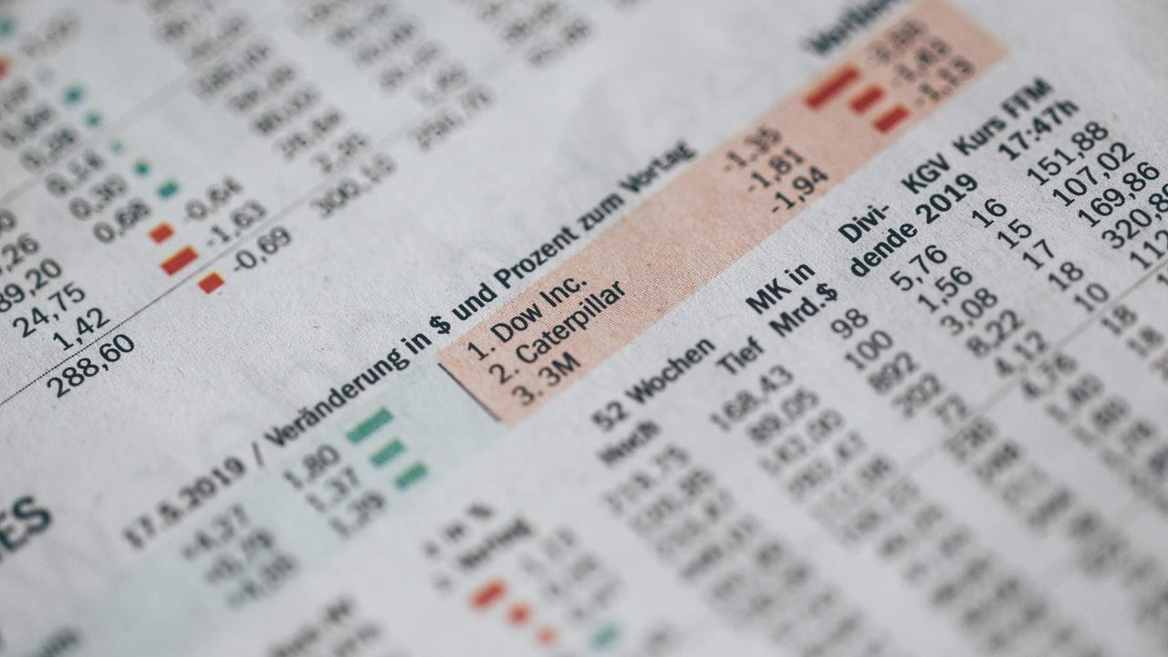
89,526,124
Whoa! That’s a big number, aren’t you proud?

Slide 20

FEATURES LIST
Login/Logout
Red
Is the color of blood, and because of this it has historically been associated with sacrifice, danger and courage.
Yellow
Is the color of gold, butter and ripe lemons. In the spectrum of visible light, yellow is found between green and orange.
Blue
Is the colour of the clear sky and the deep sea. It is located between violet and green on the optical spectrum.
Red
Is the color of blood, and because of this it has historically been associated with sacrifice, danger and courage.

Slide 21
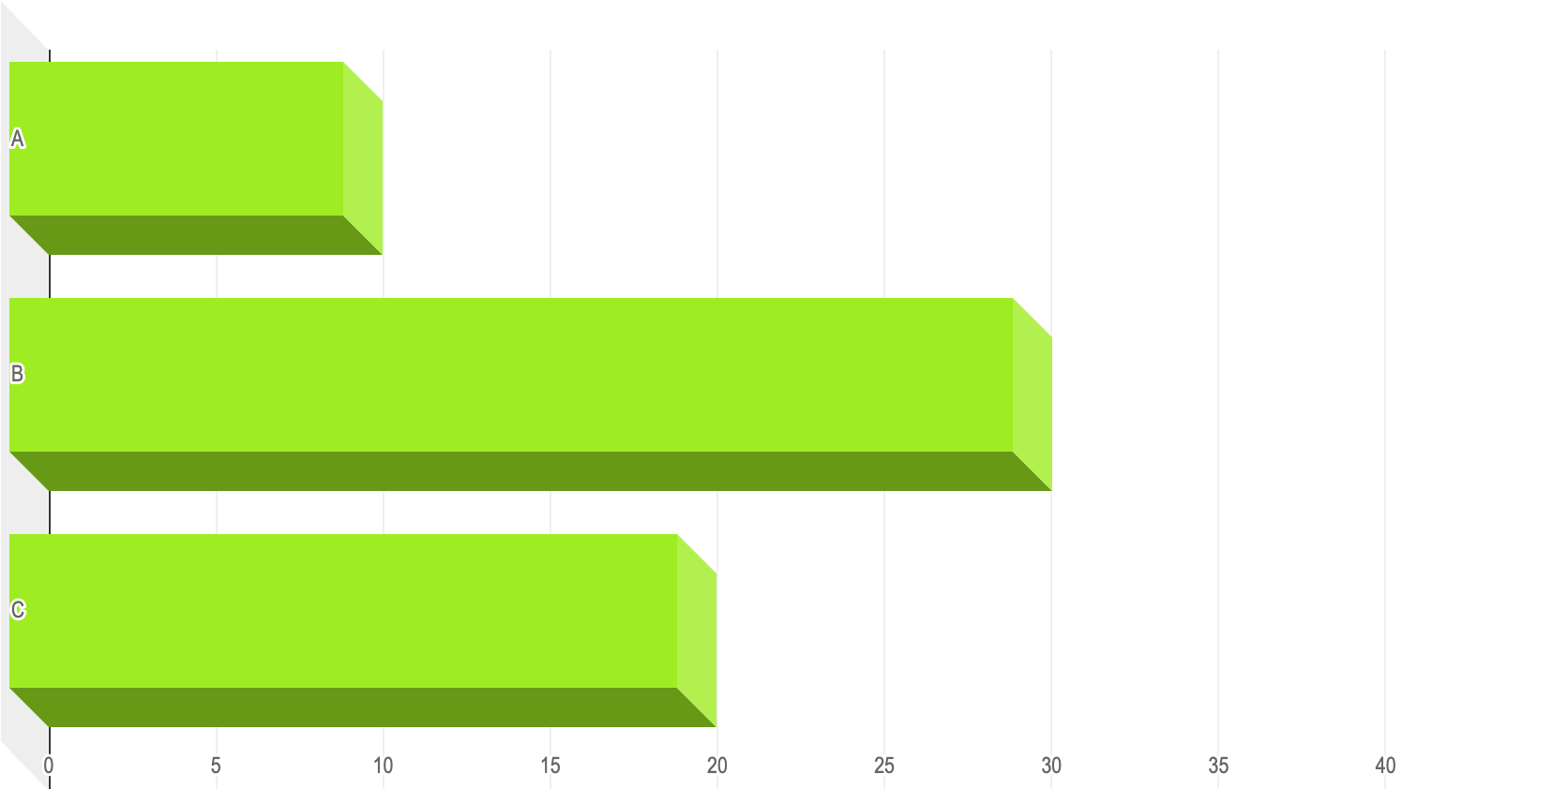
You can insert graphs from Excel or Google Sheets

Slide 22
TABLET PROJECT
Show and explain your web, app or software projects using these gadget templates.
Place your screenshot here

Slide 23
DESKTOP PROJECT
Show and explain your web, app or software projects using these gadget templates.
Place your screenshot here

Slide 24
THANKS!
Any questions?
You can find me at:
@username
user@mail.me

Slide 25
Credits
Special thanks to all the people who made and released these awesome resources for free:
Presentation template by SlidesCarnival
Photographs by Unsplash

Slide 26
Presentation design
This presentation uses the following typographies:
Titles: News Cycle
Body copy: News Cycle
Download for free at:
https://www.fontsquirrel.com/fonts/news-cycle
You don’t need to keep this slide in your presentation. It’s only here to serve you as a design guide if you need to create new slides or download the fonts to edit the presentation in PowerPoint®

Slide 27
SlidesCarnival icons are editable shapes. This means that you can:
Resize them without losing quality.
Change fill color and opacity.
Change line color, width and style.
Isn’t that nice? :) Examples:
Find more icons at slidescarnival.com/extra-free-resources-icons-and-maps

Slide 28
Diagrams and infographics

Slide 29
😉
You can also use any emoji as an icon! And of course it resizes without losing quality.
How? Follow Google instructions https://twitter.com/googledocs/status/730087240156643328
✋👆👉👍👤👦👧👨👩👪💃🏃💑❤😂😉😋😒😭👶😸🐟🍒🍔💣📌📖🔨🎃🎈🎨🏈🏰🌏🔌🔑 and many more...

Slide 30

Free templates for all your presentation needs
For PowerPoint and Google Slides
100% free for personal or commercial use
Ready to use, professional and customizable
Blow your audience away with attractive visuals

